Slide 1

Movie management app
Omri Bakal, Omri Rachmani

Slide 2
Introduction
Purpose of the App: Our Movie Management App is designed to provide movie critics with a platform to explore top-rated movies, learn more about them, and save their favorites for easy access.
Technologies Used: We built this app using Kotlin as our primary programming language. For user authentication, we integrated Firebase, and for fetching movie data, we utilized the TMDB API.
User Base: Our app is designed for movie critics who want to discover and keep track of top-rated movies.
Value Proposition: With our app, users can easily explore top-rated movies, read detailed descriptions, and save their favorites all in one place.

Slide 3
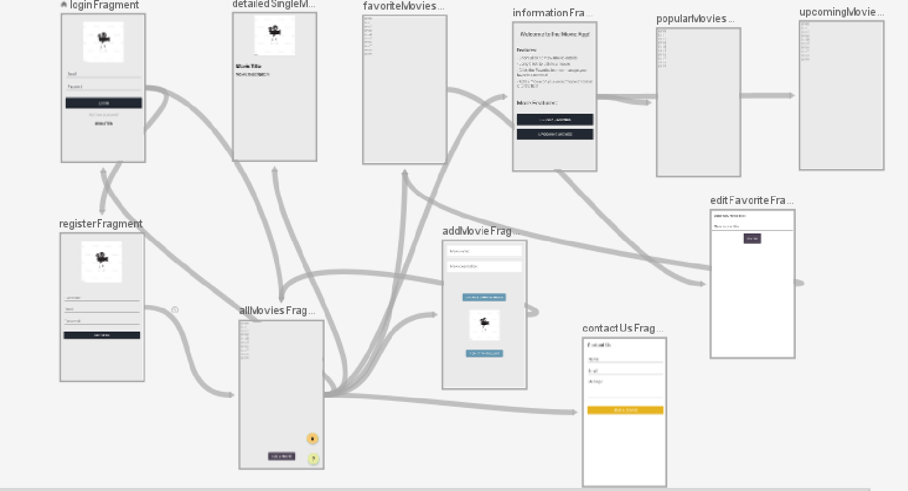
navigations

Slide 4
External libraries: Glide: Glide is a powerful image loading and caching library for Android applications, written in Kotlin. It offers a simple and efficient way to load and display images from various sources, such as URLs, local files, or even content providers. With Glide, you can easily handle image resizing, cropping, and transformations, making it convenient to adapt images to different screen sizes and aspect ratios. Hilt: Hilt is a dependency injection library for Kotlin and Android applications. Developed by Google, Hilt simplifies the process of managing and injecting dependencies into your app's components. It is built on top of Dagger, a widely used dependency injection framework, and provides a more streamlined and opinionated approach.

Slide 5

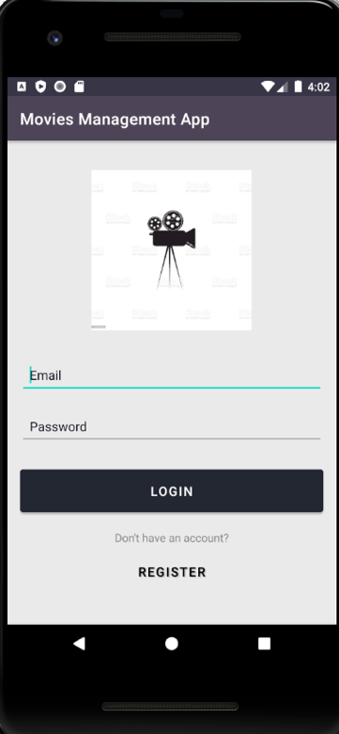
User Registration and Login
Functionality Overview: Our app provides a secure user registration and login system. New users can create an account, and returning users can log in to access their personalized content.
Error Handling: Our app provides clear error messages if a user enters incorrect login credentials or tries to register with an email that's already in use. All Errors Handling are taken care by fire base authentication.

Slide 6
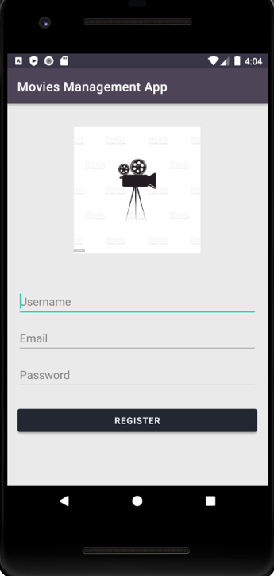
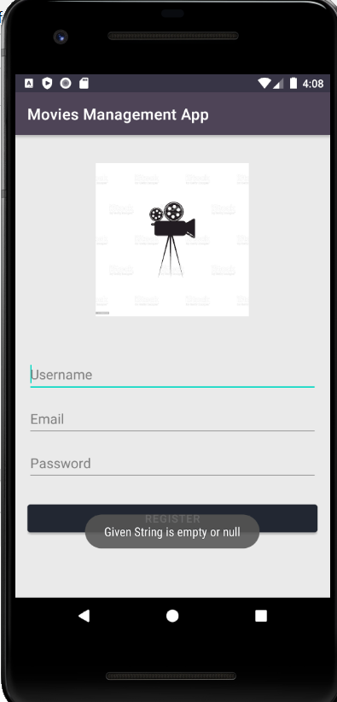
User Registration and Login screenshots

Slide 7
All Movies Page
Functionality Overview: The Movies Page is the heart of our app. Here, users can browse a list of top-rated movies fetched from the TMDB API.
TMDB API Integration: We integrated the TMDB API to provide our users with up-to-date, top-rated movies. The API allows us to fetch detailed information about each movie, ensuring our users have access to the latest and most popular films.
User Experience: We designed the Movies Page to be user-friendly and visually appealing. The movies are displayed in a clean, organized list, making it easy for users to browse and select a movie to learn more about.
Click-to-View Description: When a user clicks on a movie, they're taken to a detailed description of that movie. This feature allows users to learn more about a movie before deciding to add it to their favorites.

Slide 8
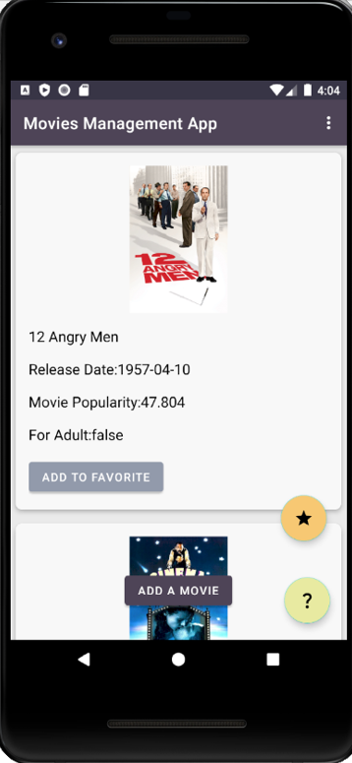
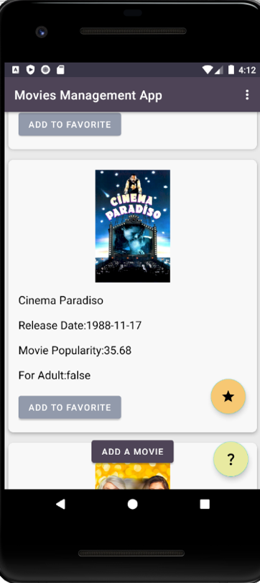
All Movies Page screenshots

Slide 9
Movie Description:
Functionality Overview: When a user selects a movie from the Movies Page, they are taken to a detailed description of that movie. This feature provides users with more information about the movie, helping them decide whether to add it to their favorites
Information Displayed: The movie description includes details such as the movie's title and brief synopsis. This comprehensive information gives users a thorough understanding of the movie.
User Experience: We designed the movie description page to be informative and easy to navigate. Users can easily return to the Movies Page or add the movie to their favorites list with a single click
Integration with TMDB API: The detailed information about each movie is fetched from the TMDB API, ensuring that users have access to the most accurate and up-to-date information.

Slide 10
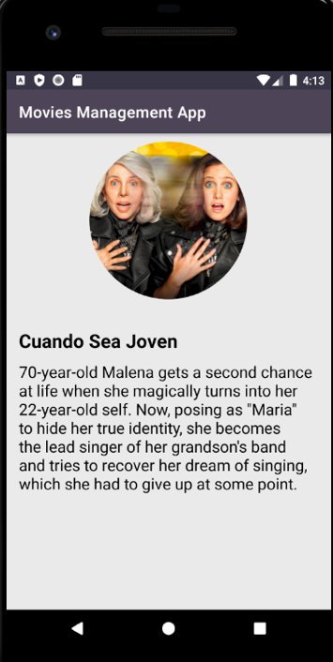
Movie Description screenshots

Slide 11
Custom Movie Addition
Functionality Overview: Our app offers a unique feature that allows users to add their own movies with custom details. This feature provides users with the flexibility to include movies that might not be available in the TMDB database.
User Experience: We designed the custom movie addition feature to be simple and intuitive. Users can easily input the movie details in a form and add the movie to the Movies Page.
Integration with Movies Page and Favorite List: Custom-added movies appear on the Movies Page alongside the top-rated movies from the TMDB API. Users can view the details of these movies and add them to their Favorite List just like any other movie.

Slide 12
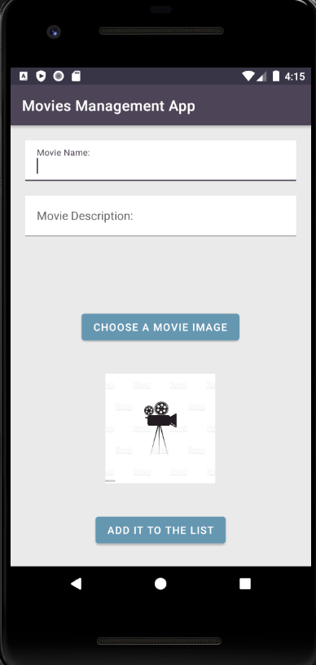
Custom Movie Addition screenshots

Slide 13
Favorites page
Functionality Overview: Our app allows users to create a personalized list of their favorite movies. From the all movies page, users can easily add a movie to their favorites list with a single click.
User Experience: We designed the favorite list to be easily accessible and user-friendly. Users can view their favorite movies at any time and remove movies from the list as they wish.
Navigation: The favorite list can be accessed directly from the movie page, providing users with a seamless navigation experience.

Slide 14
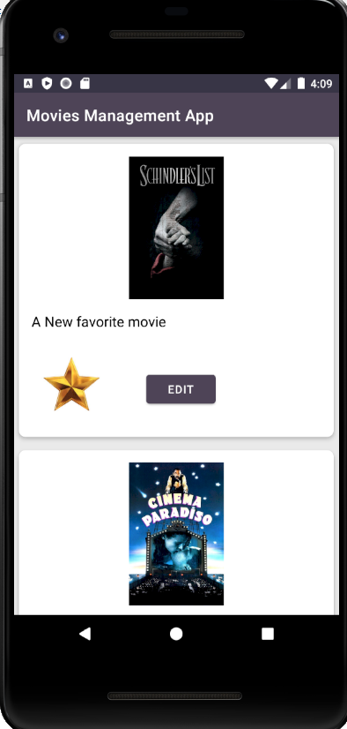
Favorites page screenshots

Slide 15

Challenges and Solutions
Challenge 1: One of the challenges we faced was integrating the TMDB API to fetch movie data.
Solution 1: We overcame this challenge by thoroughly studying the API documentation and testing different endpoints to ensure we were fetching the correct data.
Challenge 2: Another challenge was designing a user-friendly interface that was both functional and visually appealing.
Solution 2: We addressed this challenge by researching best practices for mobile app design and gathering user feedback to make iterative improvements.
Lessons Learned: These challenges taught us the importance of thorough research, testing, and user feedback in the development process.

Slide 16
Future Improvements
Improvement 1: One improvement we're considering is the integration of a search function. This would allow users to find specific movies more easily on the Movies Page.
Benefit 1: A search function would enhance the user experience by providing quicker, more efficient access to movie information.
Improvement 2: Another feature we're considering is the ability for users to rate and review movies. This would not only engage users more deeply but also provide more personalized movie recommendations.
Benefit 2: User ratings and reviews would enrich our app's content and create a more interactive and personalized experience for users.

Slide 17

Thank you!

